Slide 1

We will get started shortly…
Ensure you are using the text anchor method for anchoring whenever possible.
TIP OF THE WEEK
Text anchoring involves highlighting the desired text
Image anchoring involves drawing a box around the desired text

Slide 2

Agenda
Announcements/Reminders | Angela Kennedy
Promotional Review Standard Update: Anchoring & Annotations | Alicia Monica
Promotional Review Standard Update: Document Enhancement Request Process | Angela Kennedy
Active and Future Label Updates (Oncology) | Deanna Vise
Questions? | Angela Kennedy
REMINDER: All meeting decks can be found on the REACH site by clicking on the below links
Find PVR decks here
Find Oncology deck here

Slide 3
Announcements/Reminders | Angela Kennedy

Slide 4

Reminder – Phishing Alert!
Stay vigilant and report suspicious activity.
Recently, scammers have been using WhatsApp to impersonate executives, such as Rob Davis and Caroline Litchfield.
Read more here

Slide 5
Promotional Review Standard Update: Annotating & Referencing 2.0 (US-NON-19316)

Slide 6


High-Level Summary of Changes
Note: Please direct any A&R Standard2.0 questions to PromoOps@merck.com.
Why
In response to recent feedback, updates have been made to further streamline and improve the review process
What
Verified Dates for Website References
Note to Reviewers Requirements
Derivative Parent Anchor Requirements
Pre- and Post-Review Change Requirements
Functional Annotation Requirements
Anchoring Requirements For Indication & Safety
Training materials will be updated to include the latest guidance
For PVR, see Anchoring and Annotations - Training (ASSET-24044688)
For Oncology, see ONC Job Owner & Agency Deck – Training (ASSET-24044722)

Slide 7

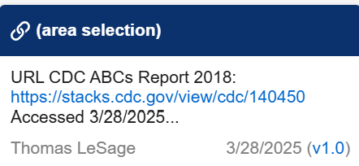
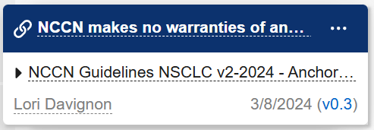
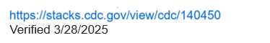
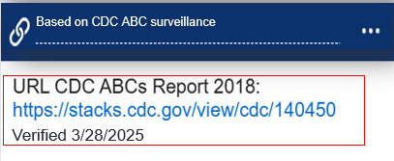
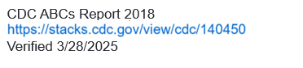
Verified Dates for Website References
[INCLUDE OR REMOVE THIS NOTE WHEN APPLICABLE]
Note: This slide is NOT applicable to Accelerated Approval presubmission assets. Follow the Presubmission Style Guide.
Based on CDC ABC surveillance
Include Verified Date in the anchor note, NOT Access Date
Access date = The date the website is uploaded into PromoMats (will be in the PromoMats Description field)
Verified date = The date the reference is checked to ensure the information has not changed
Now officially included in the Standard, website references must include the Verified Date in the anchor note
CDC ABCs Report 2018 Verified 3/28/2025
These are acceptable formats:
Reference URL + Verified Date
PromoMats Reference Name + Verified Date
PromoMats Reference Name + Verified Date + Reference URL
Important Note: References must be in Approved status at the time of AFP of the job.

Slide 8
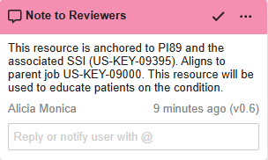
Note to Reviewers
Name the comment annotation “Note to Reviewers”
Name annotation “Note to Reviewers”
Full label identifying number no longer needed for active label brands
When listing specific labels, version # of the label is sufficient.*
*Important Note: This applies only to active label brands. Any PVR teams that do not currently include the label version can continue as is.

Slide 9
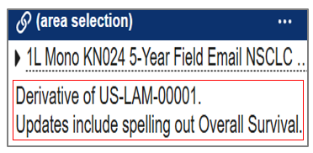
Derivative Parent Anchor Notes
Derivative Parent anchors should ONLY include “Derivative of US-XXX-XXXXX” in note
Changes from the parent NO LONGER included in the parent anchor note
Changes from the Parent are now added using dark pink comment annotations (see next slide for details)

Slide 10
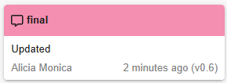

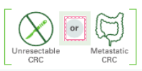
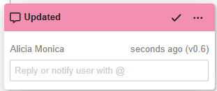
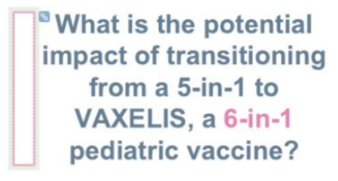
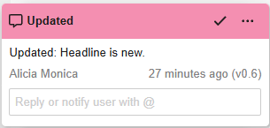
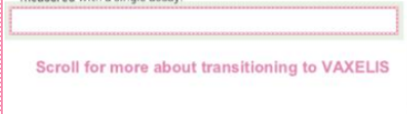
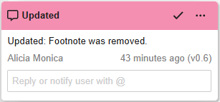
Pre- & Post-Review Changes
[INCLUDE OR REMOVE THIS NOTE WHEN APPLICABLE]
Note: This slide is NOT applicable to Accelerated Approval presubmission assets. Follow the Presubmission Style Guide.
Updated content
If highlighting, add “Updated” to the annotation description; if boxing updated content, name annotation “Updated”
Utilize dark pink comment annotations to show ALL changes—updates from the parent, new and/or removed content, and reviewer requested changes—as indicated in the examples to the right
New content
If section or slide is NEW, highlight or box new content and add “Updated: [insert new content] is/are new” to note description
Removed content
If section or slide is REMOVED, draw a box and add “Updated: [insert removed content] removed” to note description
Important Notes:
Comment annotation can be added by boxing content, highlighting text, or creating a box to the side of the content. Use the best method to avoid overlapping anchor annotations.
If boxing content, always name the annotation “Updated”; if highlighting, add “Updated” to the note description
Updates not identified with the term “Updated” within the annotation may require additional review if not called out as described within the Standard (US-NON-19316).

Slide 11
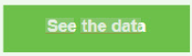
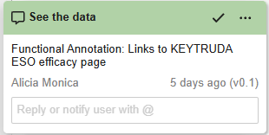

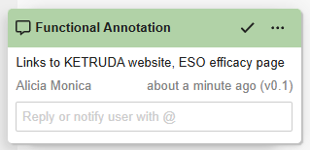
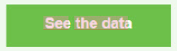
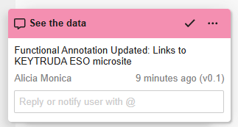

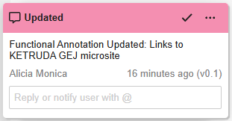
Functional Annotations: Not Required for 2253 Submission
Note: This slide is NOT applicable to Accelerated Approval and/or presubmission assets. Follow the Presubmission Style Guide.
Highlight or box the content using a light green comment annotation. DO NOT USE DARK GREEN!
See the data
If highlighting content, include “Functional Annotation: [insert functionality]” in annotation description
If boxing content, name annotation “Functional Annotation”; DO NOT block the anchor with your annotation box
Utilize light green comment annotations to denote functional annotations and name annotation “Functional Annotation”
How to Handle Updated Functional Annotations
Important Note: Updates not identified with the term “Functional Annotation” within the annotation may require additional review if not called out as described within the Standard (US-NON-19316).
If a functional annotation has changed from the prior review or parent, it should be treated as an update and placed as a dark pink comment annotation with “Functional Annotation Updated: [insert updated functionality]” to annotation description. If boxing content, name annotation “Updated.”

Slide 12
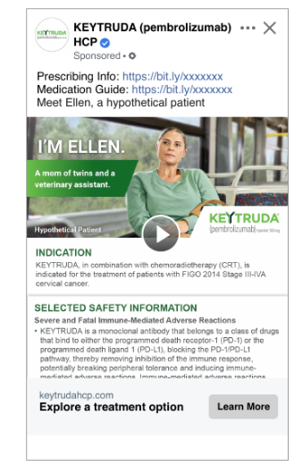
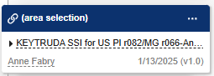
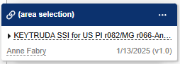
Anchoring Requirements For Indication & Safety
Note: This slide is NOT applicable to Accelerated Approval and/or presubmission assets. Follow the Presubmission Style Guide.
Indication & Safety NO LONGER require anchors to PI/ MedGuide. (This is new for Oncology)
NEW! Anchor Indication Statement and Selected Safety Information to SSI ONLY, regardless of tiering pathway.

Slide 13
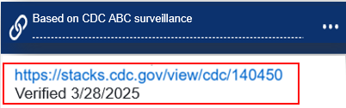
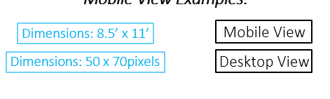
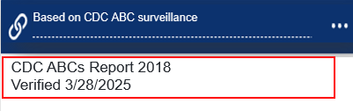
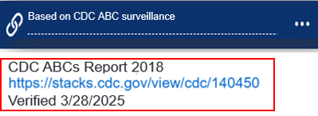
Annotation & Anchoring Requirements – Summary of Changes
Not applicable to Accelerated Approval and/or presubmission assets.
Added to Reference annotations
Added as light green comment annotations
Added as dark pink comment annotations
Added as marginal annotations
Verified Dates
Functional Annotations not required for 2253 submission
Note to Reviewers
Functional Annotations required for 2253 submission
Not Changing - Included for awareness
Pre- & Post-Review Changes (including changes from parent)
See the data
Derivative Parent Anchors
UPDATED Functional Annotations not required for 2253 submission

Slide 14





Rollout of Annotating and Referencing 2.0
Note: Please direct any A&R Standard 2.0 questions to PromoOps@merck.com.
July 25 – Aug 8
Aug 11 & Aug 18
Aug 18
Aug 11 – Sept 12
Sept 15
Review Team Training
RCLO to attend Review Team staff meetings (Aug 8) REACH Newsletter goes live after training sessions
Job Owner Inform
Two Date Options for job owners in all BUs
Attendance mandatory w/ RCLO documenting
A&R 2.0 Standard Live Intake Form Live
*Flex Period for Jobs
Jobs scheduled for CRT before Sept 15 can follow A&R 1.0 OR A&R 2.0 guidance. Boards will accept jobs adhering to either standard.
Strict Enforcement
Jobs must adhere to A&R 2.0*. Boards are permitted to deny jobs not adhering to A&R 2.0
*Exceptions will be for Market Events only, including KEYTRUDA SubQ Speed at Launch jobs as well as jobs impacted by the G9 ACIP vote
Important Note: *The flex period was put in place so jobs do not get pulled from agendas. If your job is on an agenda and scheduled for review before Sept 15, your job can proceed as is. We do not want agencies reworking jobs unnecessarily. Jobs that are scheduled for CRT on or after Sept 15 must adhere to the new A&R Standard 2.0.

Slide 15
Promotional Review Standard Update: Document Enhancement Request Process | Angela Kennedy

Slide 16

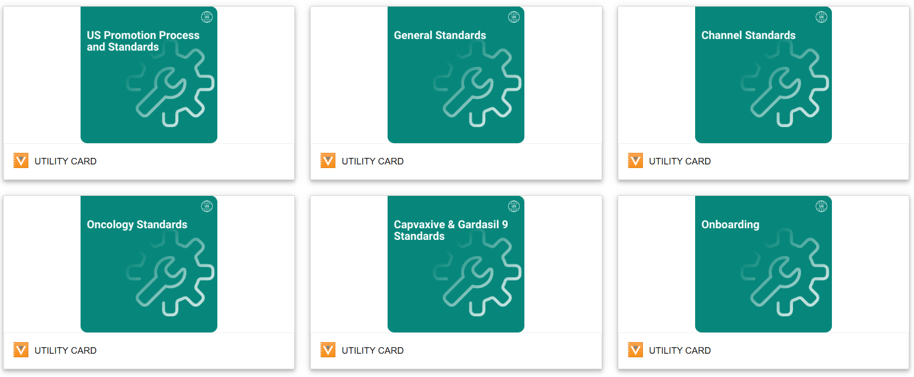
What is the Document Enhancement Request Process?
Purpose of the Process: This structured process aims to effectively manage and prioritize requests for updates to US Promotions Standards, ensuring a more organized approach to enhancements.
Historical Context: Over the past several years, Review Capabilities & Label Operations (RCLO) has received informal, ad hoc requests for updates to the Standards.
Audience: Opportunity for any job owner, review team member or team member associated with US promotions to submit a request to update a Standard.

Slide 17

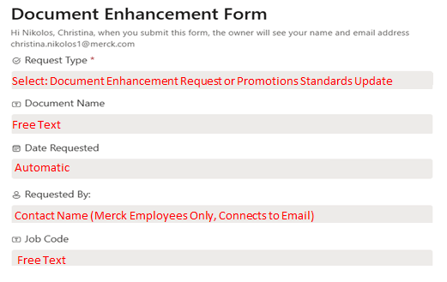
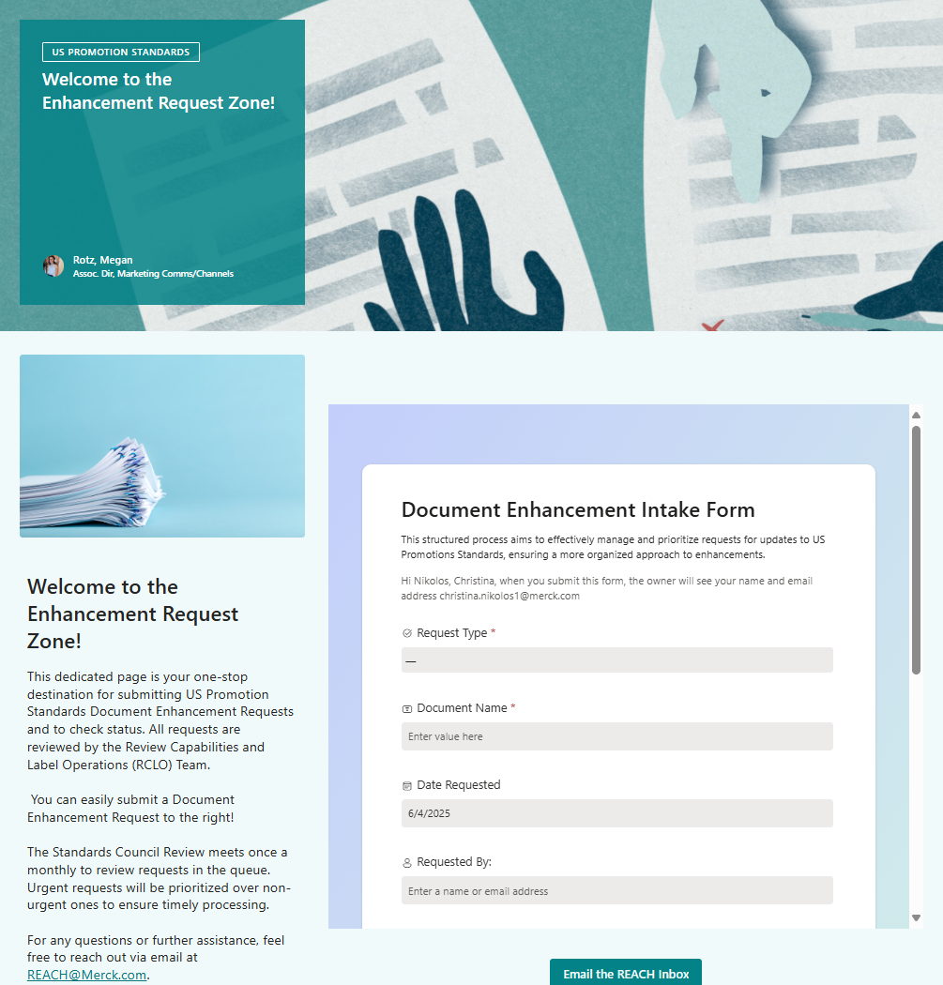
How does someone submit a request?
INTAKE
Welcome to the Enhancement Request Zone!
1
It’s easy!
Access the intake form on the REACH website and fill out nine fields:
Promotion Standard or Guidance Document
2
3
4
5
Request Type:
Choose between “Promotion Standard” or “Guidance Document”
Document Name:
Direct pull of how the document is listed in VEEVA, if new document suggest a working name for document ²
Date Requested:
Automatically Populated with today’s date
Requested by:
Enter your name and click on your contact card, this will enable direct email communication with updates on your request
Job Code:
Direct pull from job code in VEEVA, if new document enter “N/A”
Intake Fields
1
2
3
4
5
Subject to change based on standards council review team opinion

Slide 18
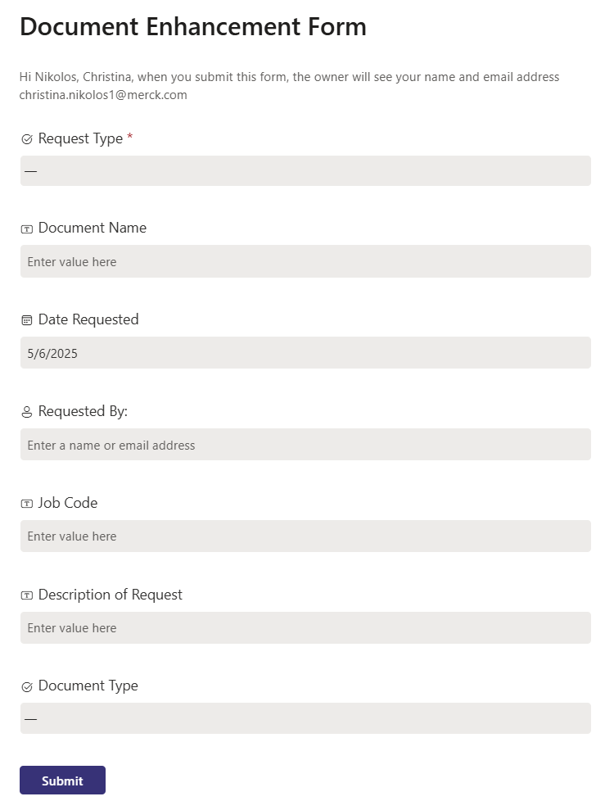
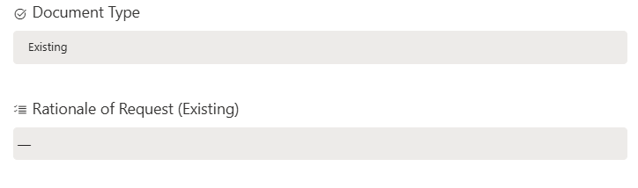
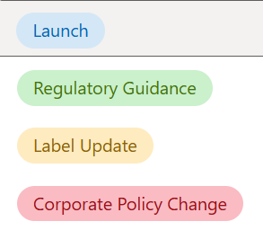
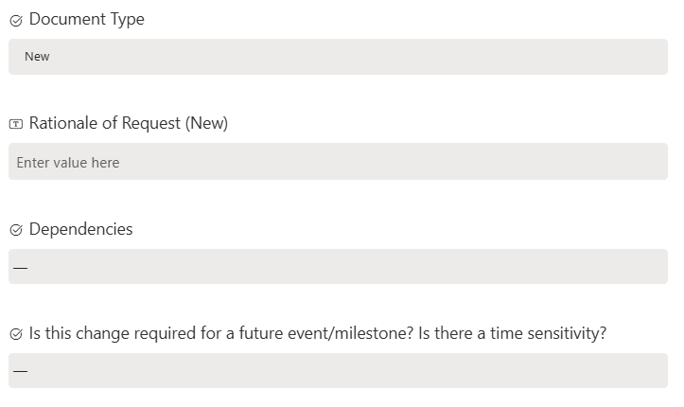
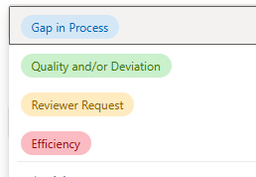
How does someone submit a request? (continued)
INTAKE
6
Free Text
Note: Request Rationale is based on document type selected:
Rationale of Request (Existing) – select all that apply as rationale for the enhancement request: Gap in Process, Quality and/or Deviation, Reviewer Request, Efficiency
Rational of Request (New) – provide 2-3 sentences of rationale for the need for this new document and the impact it will have on current library of promotion standards and current processes.
7
Select: New or Existing
Select All That Apply
8
Select All That Apply
9
(Yes or No)
Description:
Provide as much detail as possible as to why the enhancement is being requested. Identify if time sensitive (e.g. launch, regulatory guidance, policy change, or need for an internal initiative)
Document Type & Rationale:
Select if the enhancement request is for a New Document of an Existing Document, the next question will be based on your document type.
Dependencies:
Select all that apply as dependencies for the request
Future event / milestone:
If change is required for a future event / milestone or is time sensitive, select “yes”
Intake Fields
6
7
8
9

Slide 19






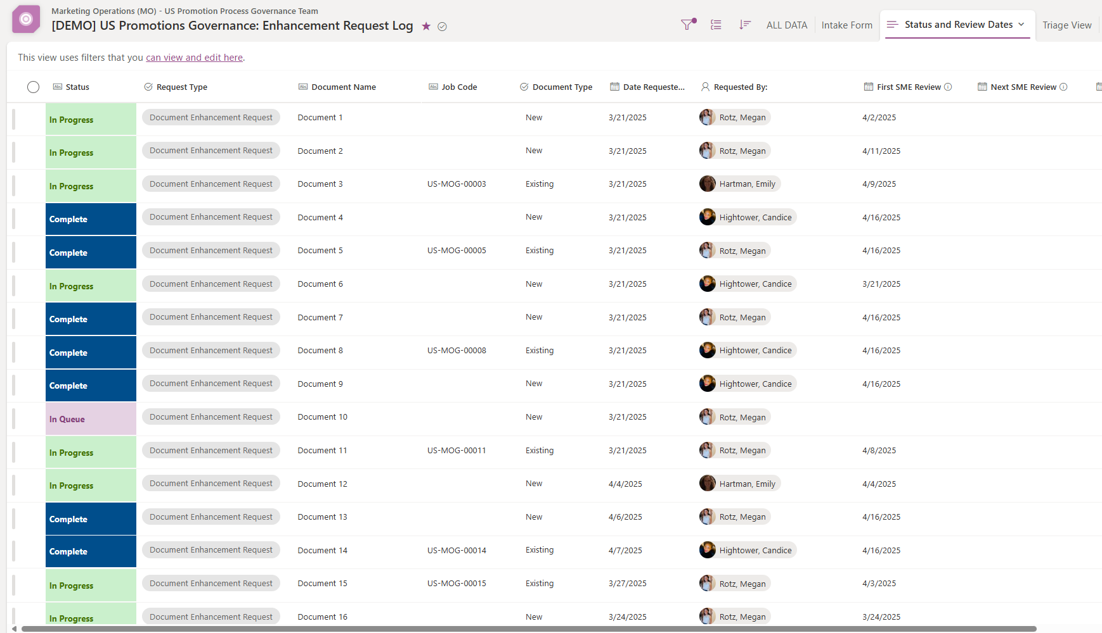
Checking Status of Requests
POST-INTAKE
Requestors can check the Status of their request(s) and any upcoming review dates via the Status and Review Dates Tab.
1
Click here to check request status
DEMO

Slide 20




Checking Status of Requests
POST-INTAKE
Status
Triage
Prioritize
Approval²
Follow up^{3,4}
Waiting For Triage: not triaged yet
In Queue¹: triaged & waiting SME assignment for review
In Progress: SME review has begun
Completed: approved by review readership
RCLO will triage each request to determine feasibility, urgency and impact via a series of questions approved by Standards Council
All factors will help determine prioritization, pull through of updates and scheduling review of standards
Once updated, will document will be reviewed/approved by Review Team leadership.
A member from the RCLO Team will get back in touch with you if we have additional questions
Status Dashboard
Notes:
Your job may be In Queue for weeks to months depending on the volume and prioritization of requests
Please note documents may require more than 1 review.
Requestors will be informed if request: i) is feasible (REACH Intake List updated to “Waiting for Triage”); iii) We will not move forward with all requests; you will receive a response if your request is not accepted, not feasible, or deemed out of scope.
Reach out to the RCLO Team with any questions.

Slide 21
Post-Triage Communication to Requestor
POST-INTAKE
A communication from the Core Team is to be sent to the Requestor once triage has been completed.
Possible outcomes:
In-Scope & Non-Urgent (lower priority items may take months to address)
In-Scope & Urgent
Out of Scope
Discussion Required
Dear [Name] –
This message is to inform you that your [Document Name] update request will move forward for review with the Standards Council. Your patience throughout this process is appreciated. The next step involves identifying Subject Matter Experts (SMEs) who will collaborate on the necessary updates. SME review dates and any additional progress related to your request can be found in the “Status and Review Dates” view. For any questions or further assistance, please reach out to your primary point of contact for this request, [Name & Email]. Thank you for your understanding, and progress on your request will be communicated as it develops.
Thank you!
RCLO Team

Slide 22

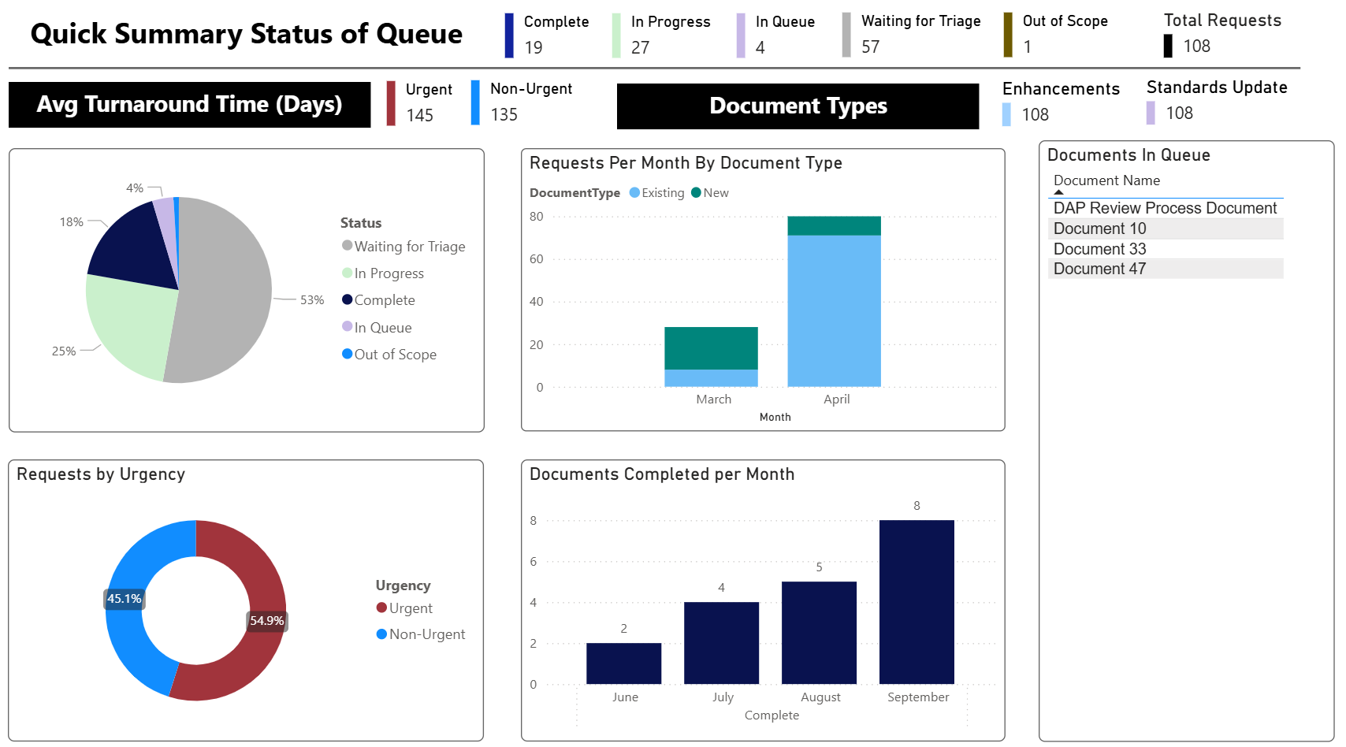
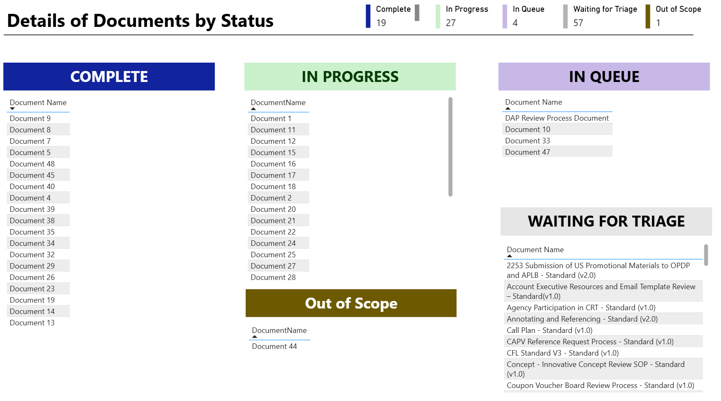
Measure
MEASURE
All data from SharePoint List is automatically ingested by a PowerBI Dashboard and updated in real time
The Core Team (RCLO) will have access to the dashboard to evaluate the process’s effectiveness, set KPIs and make improvements as needed
DEMO
DEMO

Slide 23
FAQs
What is the purpose of the Document Enhancement Request Process?
The process is designed to effectively manage and prioritize requests for updates to US Promotions Standards, ensuring a structured, organized approach to enhancements and continuous improvement.
Who can submit a request for an update or creation of a promotion standard?
Any job owner, review team member, or team member associated with US promotions can submit a request to update or create a standard.
Why is there a need for a formal process to request updates or new standards?
A formal process ensures structured collection of feedback, triage and prioritization of requests, a clear trail of decisions and actions, uniformity across the US market, and continuous improvement of processes.
How do I submit an enhancement request?
Requests are submitted via an intake form available on the REACH website’s Enhancement Request Zone. The form includes fields such as request type, document name, rationale, description, dependencies, and contact information.
What happens after I submit a request?
After submission, the request is triaged by the RCLO team to assess feasibility, urgency, and impact. It may take weeks for your request to be triaged depending on the volume of requests. The request is then prioritized and scheduled for review. You will be contacted if additional information is needed.

Slide 24
FAQs
How can I check the status of my submitted request?
You can check the status and upcoming review dates of your request via the Status and Review Dates tab in the Enhancement Request Zone on the REACH site.
What are the possible outcomes after triage?
In-Scope & Urgent: Request moves forward with priority.
In-Scope & Non-Urgent: Request is queued and may take longer.
Out of Scope: Request will not be pursued.
Discussion Required: Further clarification or discussion needed.
Who reviews and approves the enhancement requests?
The US Standards Council, composed of Review Team Leadership and Business Representatives, reviews and approves standards in monthly meetings.
How long does the synthesis and review process take?
The synthesis phase typically involves a 6-8 week sprint where the RCLO team, development team, and subject matter experts collaborate on the document updates. However, start of the synthesize step may be weeks to months after your request has been submitted based on current volume and your request’s overall urgency and impact.

Slide 25
FAQs
How is communication handled throughout the process?
The RCLO team communicates expectations, timing, and status updates to requestors and stakeholders. Approved changes are communicated via newsletters and training sessions.
What roles are involved in the enhancement request process?
Core Team (RCLO): Manages process, triages requests, coordinates reviews.
Development Team: Revises standards and synthesizes documents.
Standards Council: Reviews and approves standards.
How is the effectiveness of the process measured?
All request data is tracked in a SharePoint list and visualized in a PowerBI dashboard to monitor KPIs and identify areas for process improvement.

Slide 26
Active Label Updates | Deanna Vise

Slide 27
Oncology Active Label Updates
REMINDER: LU decks are housed here on the REACH site
May 2025 Welireg PPGL
Deadline: August 19, 2025
Point of Contact: Carleigh Bergeman
April 2025 KN-522 TNBC
Deadline: August 19, 2025
Point of Contact: Angela Kennedy
May 2025 Gastric/ESO & KN-057 NMIBC
All other assets Deadline: August 25, 2025
Point of Contact: Alicia Monica
June 2025 KN-A18 Cervical LU
Deadline: September 1, 2025
Point of Contact: Angela Kennedy
July 2025 LYNPARZA SLU
Impacts all branded LYNPARZA jobs
Deadline: September 2, 2025
Point of Contact: Carleigh Bergeman
June 2025 H & N LU
Impacts HCP + CON in PI, MG, and SSI/ISI
Deadline: September 12, 2025
Point of Contact: Alicia Monica
Important Note: KN-B68 cHL & PMBCL updates did arrive, but did not impact any jobs. Therefore, no label update activities from the Ops team will take place.
We are currently on KEYTRUDA PI r090.

Slide 28
Future Label Updates | Deanna Vise

Slide 29
Future Label Events and Launches – July to September
Label Update​ | Type of Label Update​ | PDUFA Date​ | Launch Planner/Marketing Lead​ | Notes​
KEYTRUDA Sub-q​ | Launch​ | September 23, 2025​ | Lee Ramsden/Mike Dowling​ | Anticipating approval across all KEYTRUDA solid tumor indications with Q3W and Q6W dosing schedules​

Slide 30
Questions? | Angela Kennedy

Slide 31


Questions?
Do you have a process question?
Please submit an email to our inbox!
promoops@merck.com
Important note: Our email address has changed. Please do not use oncpromoops@merck.com. This is no longer active!!

Slide 32
Thank You
PVR Huddle June 2025

